Slide 1
Electoral Integrity in Africa
Lessons from Nigeria’s 2011 and 2015 General Elections

Slide 2
Outline
Introduction
The Context
Five Key Challenges
Addressing the Challenges
Outstanding Challenges
Lessons
Conclusion

Slide 3
Introduction
Elections can have either a positive or negative impact on democratization. Whether or not the impact is positive is to a large extent related to whether or not they are conducted with integrity.
The UN Global Commission on Elections, Democracy and security has noted as follows:
“Elections can further democracy, development, human rights, and security, or undermine them, and for this reason alone, they should command attention” (Report, Sept. 2012:5)
It added that:
“For elections to embody democracy, further development and promote security, they must be conducted with integrity”

Slide 4
Intro…
Pippa Norris has observed that:
“Well-run elections, by themselves, are insufficient for successful transitions to democracy. But flawed, or even failed, contests are thought to wreck fragile regimes” (2014:3)
All these underscore the significance of elections, why attention needs to be paid to them, and why they should be conducted with integrity

Slide 5
Intro…
Since the decade of the 1990s, the era of the “wave of democratization” globally, formal democracy has been established in virtually all African countries, although its substantive features are yet to be firmly rooted.
As part of the formal trappings of democracy, elections are periodically conducted, with the aspiration of them being “free and fair”; but most of these lack integrity; are flawed and replete with irregularities, and generate negative consequences on stability, democratization and governance

Slide 6
Intro…
Although democratization has gained a foothold in Africa, and there is regular holding of elections in most countries, poorly conducted elections have imposed remarkable constraints on stability, regime legitimacy and good, democratic governance.
Increasing the scope of electoral integrity has therefore become central to the concern for democratic consolidation in Africa

Slide 7
Classification of African Regimes
Regime Type | No. of Countries Globally | No. of African Countries | Category Index
Full Democracies | 19 | 1 | 8-10
Flawed Democracies | 57 | 7 | 6-9
Hybrid Democracies | 40 | 14 | 4-5.99
Authoritarian | 51 | 21 | Less than 4.0
 | 167 | 43
Source: Democracy Index, Economist Intelligence Unit
https://en.wikipidia.org/wiki/Democracy_Index

Slide 8
Perception of Electoral Integrity Index (PEI) for African Countries
PEI Category | No. of Countries | Category of index
High to Very High (Green) | 6 | 60+
Moderate (Yellow) | 12 | 50-59
Low to Very low (Red) | 23 | Less than 50
Source: Election Integrity Project, The Year in Elections Mid-2016 Update
www.ElectoralIntegrityProject.com

Slide 9
Intro…
Scholars and researchers now raise pertinent questions as follows:
What dynamics shape the integrity of African elections?
What challenges are faced in conducting elections with integrity? And how are these addressed?
Norris has observed that: “Africa is a continent of great diversity whose elections are under-studied in comparison to Europe and America” (2015: 4)

Slide 10
Intro…
It suggests that more research and studies need to be conducted to analyze and understand elections in Africa and the scope as well as the constraints or challenges of conducting elections with integrity in the continent
I hope my project would be a useful addition to the study and understanding of how best to conduct elections with integrity

Slide 11
Intro…
For the policy practitioners, the fundamental question is: How to conduct elections with integrity, with positive impact on stability, democratization and governance
We had an opportunity to address this question in practice, for 5 years at Nigeria’s Independent National Electoral Commission (INEC)
It is a summary of that experience that I wish to share with this audience in this lecture today

Slide 12
The Context: Nigeria

Slide 13
The Context: Nigeria
Nigeria, the so-called “giant” of Africa, is a large, populous and diverse country.
Nigeria is in addition, one of few countries in the world, where whatever could go wrong has gone wrong!
Military rule (27/57)
Civil war
From Oil boom to oil curse
Ethno-religious and communal violent conflicts
Restiveness and Militancy in the Niger Delta and Insurgency in the Northeastern part of the country
Corruption and bad governance; with acute poverty amidst plenty

Slide 14
Context…
Due to the nature of its ethnic and religious diversity, Nigeria has a highly polarized political environment, characterized by ethno-religious mobilization and a history of poorly conducted elections, with associated violence

Slide 15
The Context…
With the return to civil democratic rule in 1999 elections became the legitimate means of acquiring power. But politicians deployed all means necessary to acquire ‘legitimate’ power; electoral contests were perceived as “do-or-die” affairs
Elections became mere rituals but progressively lacking in integrity. Citizens became increasingly worried that their votes don’t count. And civil rule was becoming worse than military rule in reckless misrule and bad governance. Violent conflicts were threatening national stability; lack of accountability and corruption were undermining socioeconomic development
1999, 2003 and 2007 national elections were progressively worse in lack of integrity

Slide 16
The Context…
While some citizens resorted to disengagement from the electoral arena and were becoming increasingly apathetic, organized civil society groups formed alliances and coalitions, and became more actively engaged in advocacy for electoral and wider political reforms
“Exit” v. “Voice”
This is the context in which we came into the Independent National Electoral Commission (INEC)
When appointed Chairman of INEC in June 2010, I took it for granted that it would be an easy job: “a piece of cake”

Slide 17
The Context…
As it turned out, it is easier said than done! And as with many things in Nigeria, the more you see, the less you understand!!
I soon learned a personal lesson: Never take anything for granted, never under-rate anything and never underestimate the challenges you come across
But the more general, good, lesson is that: although relatively difficult, it is not impossible to conduct elections with integrity in Africa
Requirements are: planning, effective organization, focus, resilience, relative autonomy of the Election Management Body (EMB), as well as its impartiality and integrity
Our experience in Nigeria (2010-2015) illustrates this, with good lessons for other countries in similar circumstances, especially in Africa

Slide 18
Key Challenges
We confronted six (6) major challenges:
1.) How to Strengthen the EMB, cleanse its negative image acquired over time and make it efficient and effective in the delivery of electoral services
2.) How to deal with persistent, prevalent aspects of electoral fraud, which permeated the electoral process (e.g.: ballot paper and results sheet snatching; ballot box stuffing; multiple voting; result alteration; false declaration of results; high-jacking of electoral materials; assaulting of electoral officials and vote-buying/purchase of results from collation and returning officers, etc.)
3.) How to secure the integrity of the electoral roll/ Register of Voters

Slide 19
Key Challenges…
4.) How to make election day logistics and procedures transparent, accountable and efficient
5.) How to create a level playing field for all parties and all contestants
6.) How to protect and strengthen the relative autonomy of the EMB, in its relations with the political parties, the legislature and the incumbent executive arm of government

Slide 20
Tackling the Challenges
We tried to address these major challenges as follows:
1.) Restructuring and reorganization; planning; programming; focused implementation; motivation and discipline (“carrot-and-stick”); leadership by example
2.) Usage of technology to secure sensitive election materials; unique/unconventional election day procedures; careful selection of Presiding, Collation and Returning officers
3.1) Biometric registration; smart voters card and smart card reader

Slide 21
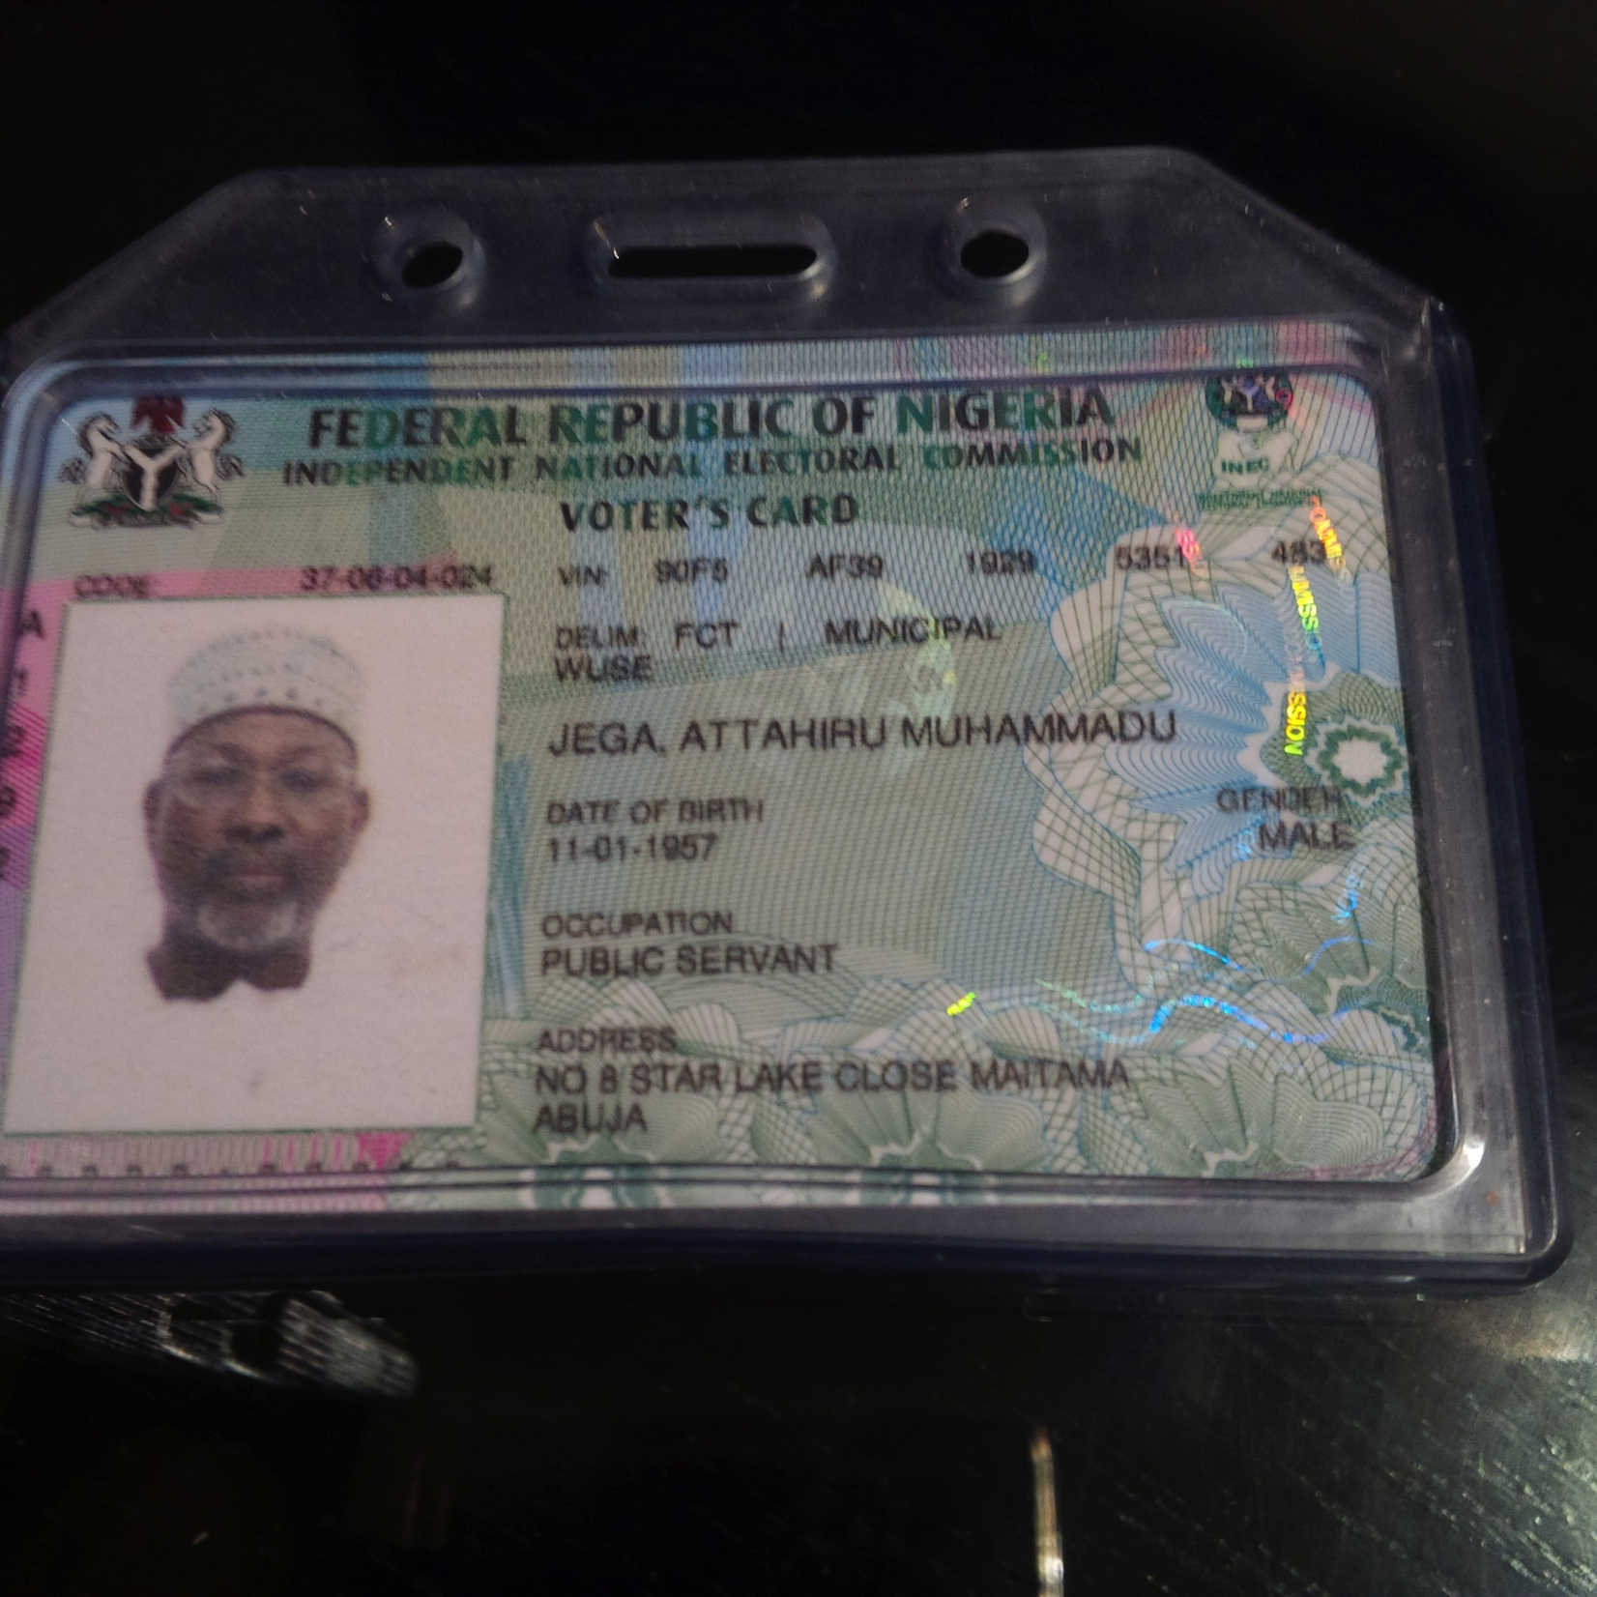
Smart Voters Card

Slide 22
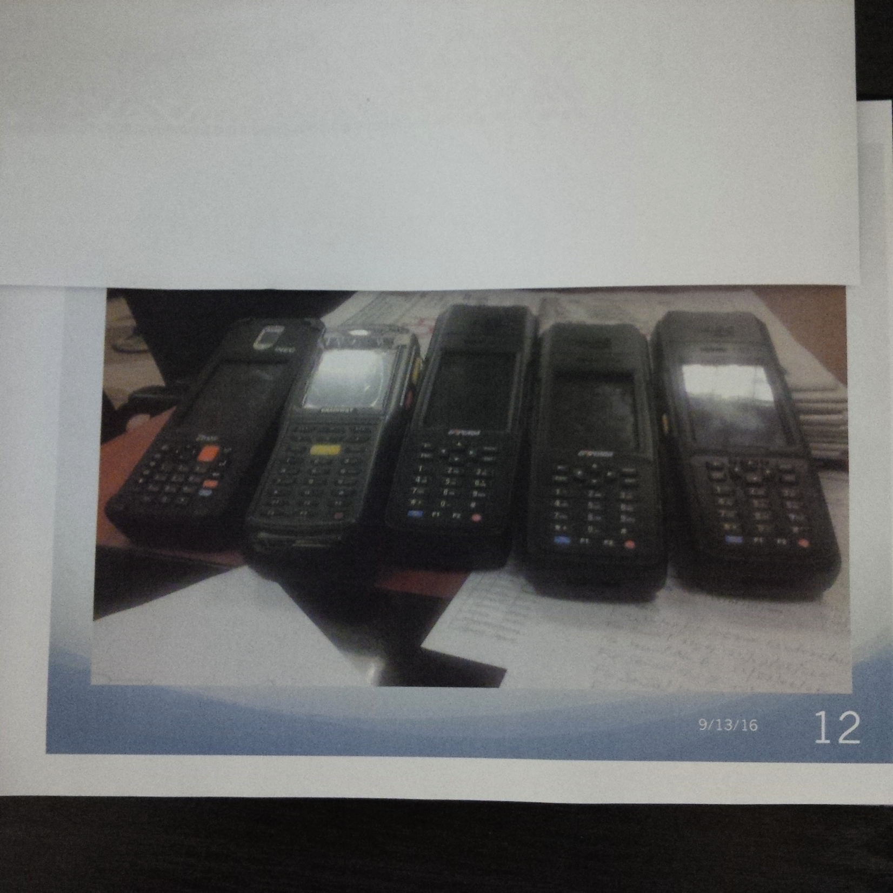
Smart Card Readers

Slide 23
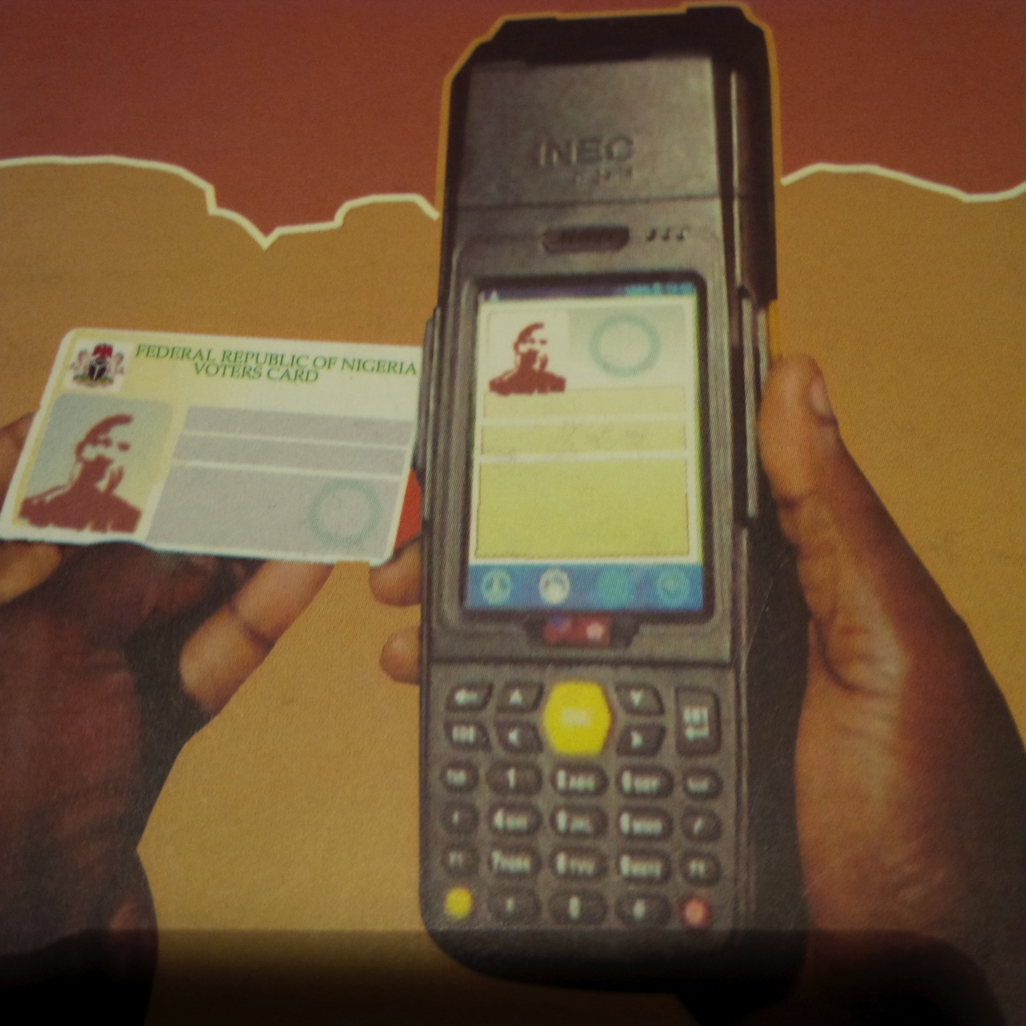
Verification

Slide 24
Biometric Authentication

Slide 25
Tackling the Challenges…
3.2) Online verification of registration status using SMS;
3.3) Scanning and uploading od result sheets on a secure database accessible via link to the website
4.1) Decentralized distribution of election materials; partnered with the Road transport workers union for movement of personnel and materials for elections; partnered with the Armed Forces for movement in difficult terrain
4.2) GIS Geo-referencing of all polling units and extensive mapping

Slide 26
Tackling Challenges…
5.) Redefined mode of engagement with key stakeholders for transparency and accountability
Political parties
CSOs
Media
Security
Government
Traditional and religious leaders

Slide 27
Tackling the Challenges…
6.1) Strove for impartiality, non-partisanship and integrity
6.2) Struggled with corruption within and without
6.3) Struggled with ethno-religious mobilization

Slide 28
Outstanding Challenges
Some of the outstanding challenges are as follows:
Voter Education for increased participation
Change Management training for staff
Ethno-religious mobilization
Influence of money in politics
Technological adaptation
“Do-or-Die” mindset of politicians

Slide 29
Lessons
It is difficult, but not impossible
Don’t underrate or underestimate the challenges
Review and study past experiences and learn and don’t repeat mistakes of the past
Learn from others and share knowledge and experiences
Be focused and resilient; don’t get sucked into the rot around you
Engage stakeholders constantly

Slide 30
Lessons…
Plan strategically as well as specifically
Strategic plan; Election Project Plan (EPP); Election Management System (EMS); Elections Operations Support System (EOPS)
Have a rigorous monitoring and evaluation system
(Registration and Elections Review Committee (RERC) Report; Retreats; stakeholder validation meetings, etc.)

Slide 31
Conclusion
Nigerians have aspired and struggled for democracy and have been repeatedly frustrated by reckless misrule, legitimated by badly conducted elections
After the 2007 elections, which were considered by international and domestic observers to be the worst in Nigeria’s history, citizens coalitions in CSOs pressurized the government for electoral and political reforms
This led to the setting up of an Electoral Reform Committee, the acceptance of many of its recommendations, amendments to the electoral legal framework and the reconstitution of the Electoral Commission

Slide 32
Conclusion…
This, in turn, paved the way for the introduction by the new Commission of many initiatives and innovations, which remarkably added value to the integrity of the 2011 and 2015 general elections
The key challenge now is how to ensure sustainability, and incremental value addition of electoral integrity, not to allow reversal of the gains made

Slide 33
References
Electoral Integrity Project, The Year in Elections Mid-2016 Update, September 2016. www.ElectoralIntegrityProject.com
“Democracy Index”, Wikipedia, https:/en.wikipedia.org/wiki/Democracy_Index
Norris, P., Why Electoral Integrity Matters, Cambridge University Press, 2014
Norris, P., in Martinez i Coma, F. and M. Gromping, Electoral Integrity in Africa, Hanns Seidel Foundation, 22 June, 2015.
United Nations, Global Commission on Elections, Democracy and Security, Deepening Democracy: A Strategy for Improving the Integrity of Elections Worldwide. Report, September 2012.

